Slide 1

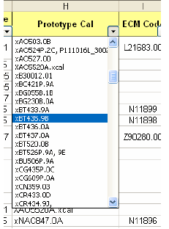
Using the Xcal Tracking Report to find a Calibration
This document can be found on the INCAL disc under:
Xcal/Xcal Tracking Report for Incal for (Month and Year of INCAL disc)
Use the dropdown filter selection under the Prototype Cal column to sort for the Xcal ECM code that you are looking for. To figure out the Xcal ECM code, please refer to the Xcal Tracking Report Spreadsheet that describes the naming conventions.
The extension .XX is not critical for finding the development ECM code. Instead, make sure to match the characters to the left of the decimal point. These correspond to OEM, FR number, and phase.
You may also filter by OEM Name, OEM Model, etc. to find your ECM code in the event you do not know your prototype cal number.

Slide 2
Using the Xcal Tracking Report to find a Calibration
3. After you select the proper prototype calibration (or find the proper cal using OEM Name and OEM Model), the information on the calibration will be displayed as shown below. The amount of information available will vary from Xcal to Xcal. Check to confirm that the OEM name, OEM model, and OEM application are what you expect.
4. If the rated power is not what you expect, this may be due to the fact that the data plate may correspond to a generic calibration (used during calibration development) and the information has not been updated to the correct information.
5. All of the information that we have on the calibration will be listed. If an ECM code is listed, there is a good chance you can find the calibration on the INCAL disc. To get the calibration, go to the intelect folder on the INCAL disc, choose esdn, choose data, choose your platform, choose cal, and then look for the calibration that corresponds with the part of the ECM code that is to the left of the decimal point.

Slide 3
Using the Xcal Tracking Report to find a Calibration
IMPORTANT DIFFERENCES:
1. Sometimes you will see a calibration such as xAC8390A.cal. The identification is actually xAC839.0A. In these cases the developer did not strip off the extra information before putting the information in the database. THE IMPORTANT PART OF ALL CALIBRATIONS ARE THE FIRST 6 OR 7 POSITIONS. THESE CHARACTERS ARE WHAT YOU ARE TRYING TO MATCH UP WITH.
2. A calibration that is xAC839.0B is the same as xAC839.0F when you are replacing it with the released ECM code calibration. The .XX indicator is just a version reference used in the development of the released calibration.
3. A calibration that looks like Z90726.99 has been made by PowerMatch. The only way to figure out what calibration this corresponds to is to trace it back to the distributor or, If it has been released, you will need to match a released calibration to the exact OEM name and model.

